Slide 1
BAF II Guidelines: Grant Claim Procedure

Slide 2
Six-step process
Step 1: Log-in to your BAF II account, using the BAF II website.
Step 2: Complete the reimbursement form, and attach scans of all supporting documents.
Step 3: The BAF II team will review the claim, and get in touch if anything seems to be missing.
Step 4: When the BAF II team advises, download and print the claim form for signature.
Step 5: Bring the signed and stamped claim form, and original supporting documents, to the BAF II office, for passing to MoIC.
Step 6: Grant payment will be made by MoIC.

Slide 3
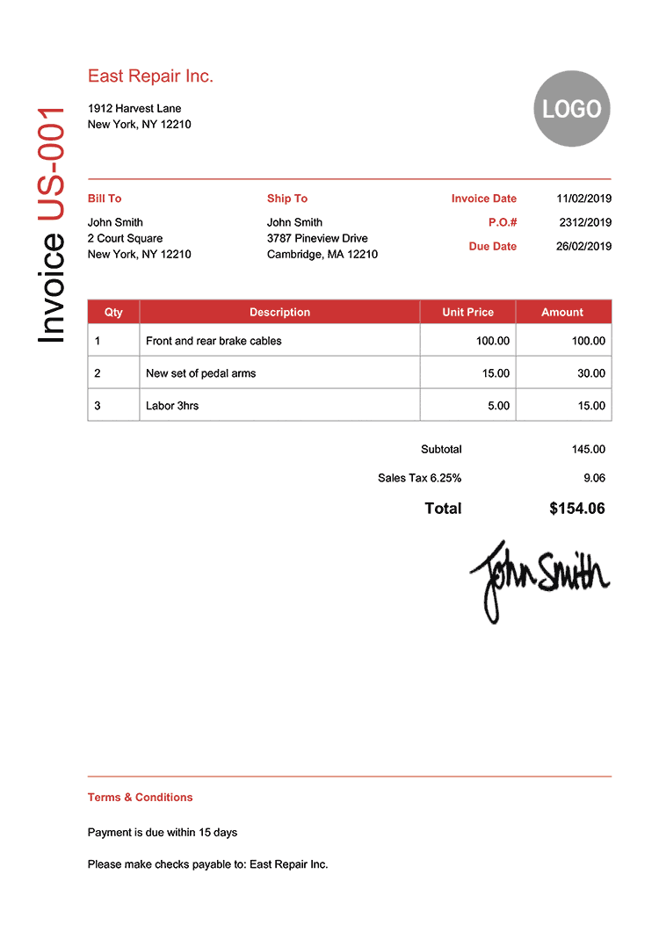
Sample invoice from BDS provider
Name and address of BDS provider: Must be the same as in the letter of agreement (LoA) for the grant.
Name and address of grantee company: Must be the same as in the letter of agreement (LoA) for the grant.
Dates: Please make sure the invoice is dated after the letter of agreement (LoA) date, and before the money transfer and payment receipt date.
Tax: Please do not forget to exclude any tax from the claim. This is because BAF II will pay all relevant taxes.
Signature and stamp of service provider: Must be an original only. Electronic or scanned signatures and/or company stamps are not acceptable.

Slide 4
Sample payment receipt from BDS provider
Name and address of BDS provider: Must be the same as in the letter of agreement (LoA) for the grant.
Date: Please make sure the receipt is dated after the money transfer and invoice dates.
Receipt number: The receipt must have a reference number.
Name and address of grantee company: Must be the same as in the letter of agreement (LoA) for the grant.
Tax: Please do not forget to exclude any tax from the claim. This is because BAF II will pay all relevant taxes.
Signature and stamp of service provider: Must be an original only. Electronic or scanned signatures and/or company stamps are not acceptable.

Slide 5
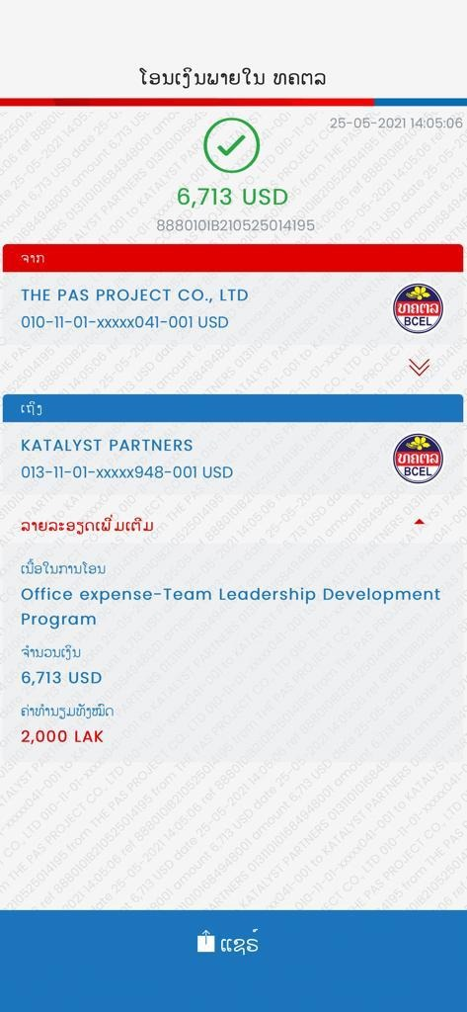
Evidence of payment for BDS services received
Date: Must be after the date of the letter of agreement (LoA), and the date cited on the invoice.
Name of grantee’s company
Payor: Must be made by the grantee / client company in the agreement (LoA) for the grant.
Name of service provider
Payee: Must be to the BDS provider stated in the letter of agreement (LoA) for the grant.
Form: Must be in the form of a bank transfer, unless otherwise agreed in the letter of agreement (LoA).

Slide 6
Please do not hesitate to contact the BAF II team for further information.
BAF II
LNCCI (Room #20)
Kayson Phomvihane Ave Phonphanao Village
Saysettha District, Vientiane Capital, Lao PDR
Tel: 020 55542658
Email: info@baflaos.com

