Slide 1
BAF II Guidelines: Grant Application Procedure

Slide 2
Six-step process
Step 1: Business advisory and on-line grant application (free of charge)
Step 2: Grant application is reviewed and processed by BAF II team
Step 3: Grant application is considered and approved by MoIC
Step 4: Grantee company implements the BDS activities
Step 5: Upon completion of activities, grantee company submits grant disbursement request
Step 6: Grant is disbursed by MoIC

Slide 3
Step 1: Business advisory and on-line grant application (free of charge)
Contact our office, or on of our our Business Advisors, @020 55542658, to express your interest in receiving BAF II support.
An appointment will be made for a BAF II Business Advisor to meet with you. The aim of the first meeting is to assess whether or not BAF II can support your business. If the answer is yes, you will be advised to proceed the next step.
Complete an online application form via our website (www.baflaos.com) and upload the required documents.
The application will be considered ‘Complete’, and ready for review, when the following supporting documents have been provided:
Enterprise Registration Certificate and Tax Registration (if applicable);
Quotation from the service providers with detailed cost breakdown for services fees;
Profile of the technical service provider (eg. CV of the experts, business track record and/or company profile);
Work plan and details of the required deliverables (if applicable).
When completed, you will get an email notification with the Application Number ‘BAFII_XXXX’.

Slide 4
Steps 2 and 3:
Grant application is reviewed and processed by BAF II team
Grant application is considered and approved by MoIC
Your application will be checked and reviewed for completeness. You will be contacted if the application needs to be revised and improved, and more information or documents are required.
When the BAF II team is satisfied with the application and supporting documents, a ‘Letter of Recommendation (LoR)’ will be prepared and submitted to the Ministry of Industry and Commerce (MoIC) for their review.
Once the MoIC has reviewed the LoR, they will decide to approve or not approve. (The MoIC may ask for additional information, or request for further clarification.)
If approved, a ‘Letter of Agreement (LoA)’ will be drafted, in both Lao and English, which serves as the grant contract. The LoA will be signed by a representative of the MoIC and the grantee company, setting out the rights and responsibilities of both parties, and all necessary ‘deliverables’.
Of not approved, BAF II and the applicant company will look to see how the application can be revised and re-submitted to MoIC.

Slide 5
Steps 4, 5 and 6:
Grantee company implements the BDS activities
Grantee company submits grant disbursement request
Grant is disbursed by MoIC
After the LoA is signed, the company can start implementing the BDS activities covered by the grant agreement.
It is important that the grantee company keeps a careful record of all proof of BDS activity implementation. Please check the ‘Agreed Deliverables’ section of the LoA, which lists the evidence of ‘deliverables’ necessary for grant disbursement to occur.
Please also note that, unless previously agreed, only bank transfers are accepted as proof of payment between the company and the BDS provider.
Once the BDS activities have been completed, log-in to your account on the BAFII website, and then: i) complete the ‘Reimbursement Form’; ii) attach the agreed ‘deliverables’ listed in the LoA; and then iii) press submit.
The reimbursement request is checked by the BAF II team, and if everything is in order, then a request for grant payment will be sent to the MoIC.
MoIC will issue a bank cheque to the grantee company. (More detailed information on ‘Claims and Disbursement’ can be found in a separate guideline.)

Slide 6
Sample of a quotation from a BDS provider
Service provider information:
For a legal entity, the name of the company must be the same as its Enterprise Registration Certificate
For a freelance consultant, the full name of the consultant must be provided
Date must be included in the quotation
Breakdown cost of all proposed activities
Exclude VAT in the total cost
Signature and Stamp (if applicable) of service provider

Slide 7
Sample company profile of BDS provider
The company profile of the BDS provider should include, but not necessarily be limited to:
Description of the business, including its history, mission and growth trajectory.
Description of its products and/or services.
Demonstrated experience in prior assignments related to the proposed activities.
What we need to see is information that explains why you think this is a good choice of BDS provider for your needs.

Slide 8
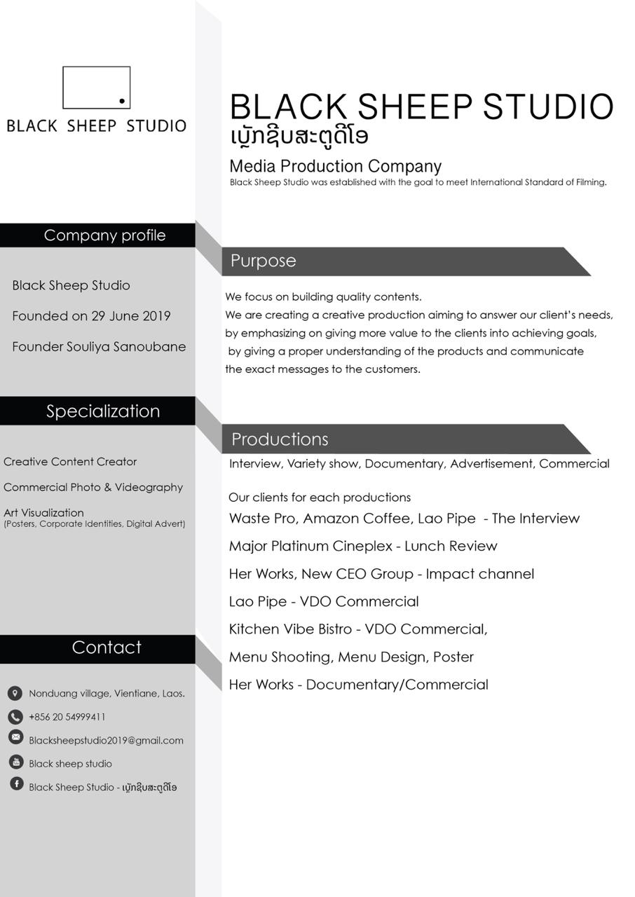
Sample CV of freelance BDS provider
The CV should provide details of the freelance provider’s educational and/or professional background, and prior consulting work experience that is relevant to the assignment.
What we need to see is information that explains why you think this is a good choice of BDS provider for your needs.

Slide 9
BAF II’s on-line application process (1)
Step 1: Click on Register (both Lao and English available)

Slide 10
BAF II’s on-line application process (2)
Step 2: Fill in your information in the register, as BAF Client, if you want to apply for a grant.

Slide 11
BAF II’s on-line application process (3)
Step 3: Go to Login, and insert the email address and password you used to register in step 2.

Slide 12
BAF II’s on-line application process (4)
Step 4: Click on new application.

Slide 13
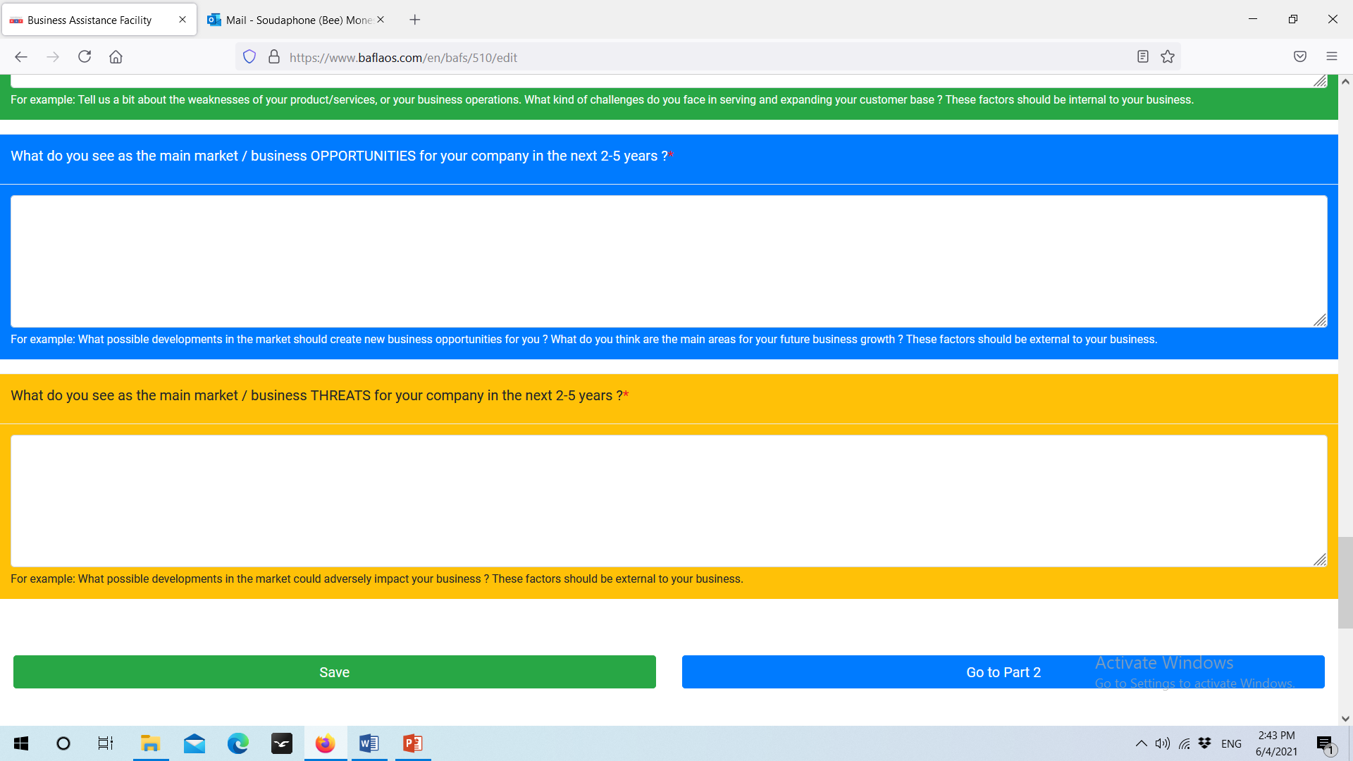
BAF II’s on-line application process (5)
Step 5:
Submit the required information:
Part 1: Company information.
Part 2: Summary of your business growth plan.
Part 3: The BDS activities that you want to implement.
Please don’t forget to save your information when you have finished parts 1, 2 and 3. If not, you will lose all the information you submitted.

Slide 14
BAF II’s on-line application process (6)
Step 6:
Attach your enterprise registration license
Attach: i) Enterprise Registration Certificate and Tax Registration, if applicable) , ii) Quotation from the service provider, with detailed cost breakdown for services fees; iii) Profile of the technical service provider; iv) Workplan and details of the required deliverables.
When you have finished parts 1, 2 and 3, please click ‘Review’ before submitting.
If you want to change your information, go to edit.

Slide 15
BAF II’s on-line application process (final step)
Final step:
After you have completed and reviewed all the information, please click the ‘Submit’ button.
You will then get automatically receive an email notification with a dedicated grant Application Number ‘BAFII_XXX’.

Slide 16
Please do not hesitate to contact the BAF II team for further information.
BAF II
LNCCI (Room #20)
Kayson Phomvihane Ave Phonphanao Village
Saysettha District, Vientiane Capital, Lao PDR
Tel: 020 55542658
Email: info@baflaos.com

